Slide 1
I. Choose the word whose underlined part is pronounced differently from the others
1. A. cold B. volleyball C. telephone D. open
2. A. meat B. reading C. bread D. seat

Slide 2
3. A. writes B. makes C. takes D. drives 4. A. favourite B. name C. happy D. danger 5. A. end B. help C. set D. before
/s/
/s/
/s/
/z/

Slide 3
II. Choose the word with the different stress syllable
‘
‘
‘
‘
1. A. waterfall B. historic C. fantastic D. pagoda
2. A. hospital B. bakery C. stadium D. hotel
3. A. brother B. doctor C. sister D. sixteen
4. A. armchair B. hello C. police D. eraser
5. A. living B. fifteen C. mother D. people
‘
‘
‘
‘
‘
‘
‘
‘
‘
‘
‘
‘
‘
‘
‘
‘

Slide 4
III. Choose the correct answers.
1. My grandfather ……………………….fishing in his free time.
A. does B. do C. goes D. go
2. ............................... sports do you play?
A. what B. which C. why D. how
3. Where are you, Hoa? I’m downstairs. I ……………….to music.
A. to listen B. listen C. listens D. am listening
4. This Saturday we …………………………. to the Art Museum.
A. go B. is going C. are going D. went
5. I like ................... programmes. They make me laugh
A. horror B. comedy C. national D. local
6. Which shirt is ………………….., this one or that one?
A. cheap B. the cheapest C. cheaper D. more cheap

Slide 5
7. Who ............ you ................ badminton with yesterday?
A. do - play B. did - play C. are – play D. did - played
8. .....................is a man on a television or radio programme who gives a weather forecast
A. MC B. weatherman C. newsreader D. viewer
9. We use the .................... to change the channel from a distance
remote control B. volume button C. TV D. laptop
10. We …………....keep quiet in the library so that everyone can enjoy reading books.
A. shouldn't B. should C. can ’t D. can
11. A: ................ do you play football? B: twice a week
A. what B. why C. how often D. how

Slide 6
12. Both educational channels .............. TV cartoon series always teach children life lessons.
A. so B. and C. but D. or
13. ............... The Little Big Shots is a famous American television series, I have never watched it.
A. Because B. Although C. So D. But
14. I .......... at the .......... last Sunday, but I did not see you there
was - gym B. were - football
C. am - gym D. did - gym
15. How many goals did you .............. in total?
A. scored B. scores C. score D. scoring

Slide 7
IV. Read the passage then answer the questions. American students usually attend an elementary school in their neighbourhood. The school year usually runs from early September to mid-June. School days last from Monday to Friday. Classes start at 9 a.m and finish at 3 p.m. Students have a two-week vacation, a one-week spring vacation and two-month summer vacation. Elementary school programs consist of language arts, history, geography, maths, science, music, art, physical education and health. In big cities, many students live close enough to walk to school and come home for lunch. However, most elementary schools have a canteen. Students can go there at break-time. They can buy some snacks and drinks there. 1. The school year usually begins in late September. 2. Students often have lessons five days a week. 3. In the summer, students have a two-month vacation. 4. Students can buy some snacks and drinks at a food-stall. 5. Many students living near the school have lunch at the canteen.
F
T
T
F
F

Slide 8
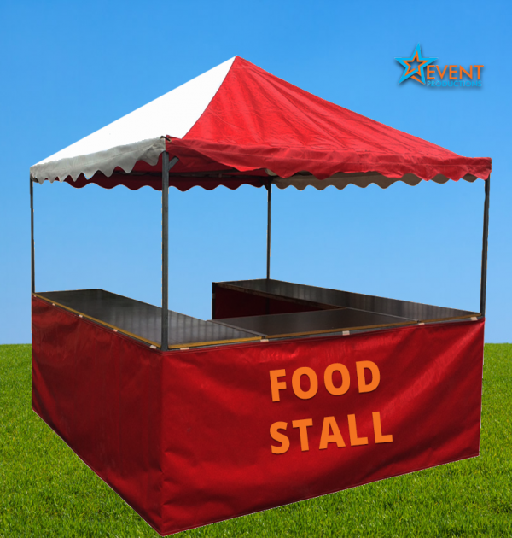

Slide 9
V. Rearrange the words to make meaningful sentences 1. camping / often / do / how / you / go? 2. should/ do / you / your homework / to / go / school / before / you
How often do you go camping?
You should do your homework before you go to school.

Slide 10
VI. Rewrite the sentences so that its meaning stays the same 1. Hanoi is large, Bangkok is larger and Tokyo is the largest. → Tokyo is the three cities. 2. The garden is behind Lan’s house. → Lan’s house 3. Please tell me something about your school. → Can
is the largest of
is in front of the garden.
you tell me something about your school?

